Slide 1
Linux
Incident Response

Slide 2
Linux vs Windows
So far, mostly Windows
Many organizations primarily use Windows
With some Linux server
Similarities when thinking about IR
Proper defense
Selinux
Logging enabled
Host based is slightly more difficult
No sysmon

Slide 3
Filesystem
Different than Windows
Setuid binaries
If a user can run a setuid binary that changes permissions to root…
Setguid binaries
Setting group of a user to the root user groups
Hidden files
Windows has this too
Anywhere that’s world writable
/tmp

Slide 4
Users
No Active Directory to worry about .. usually
Make sure there aren’t any extra users
Linux has a list of extra users by default
Correct groups
Sudoers
File declares who is allowed to use “sudo”
Bash history for all users
Modified passwords?

Slide 5
Logging
All logs in one place
/var/log
Auth.log
Successful/Failed authentications
Attempts to sudo
Application specific logging
Apache2
Access & error

Slide 6
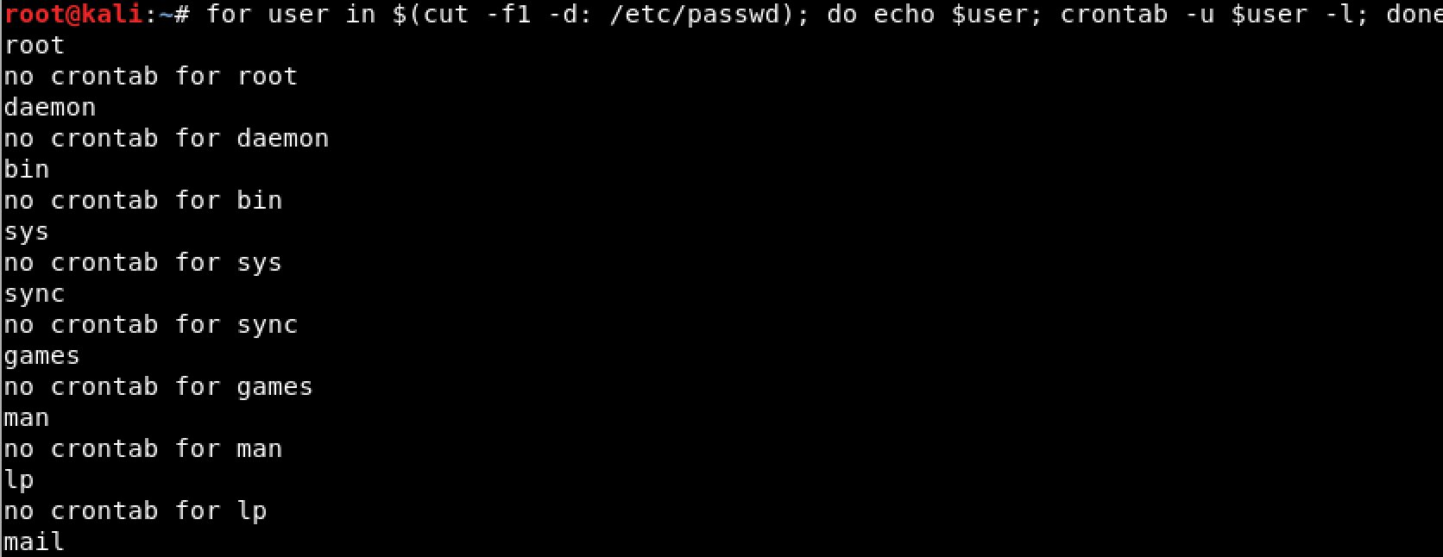
Services & cron jobs
Services
Similar to Windows Services
Services sometimes run with elevated permissions
Webserver and www-data
Cron jobs
Similar to Windows Scheduled Tasks
Can be from multiple user contexts

Slide 7
Access Methods
SSH
Most common way of accessing a linux system
Attacker installs SSH keys into authorized users
Changes sshd config
VNC/Remote Desktop
Typically not enabled

Slide 8
Backdoored Libraries/Rootkits
Persistence mechanism
passwd
pamd
sshd
What if system binaries are altered as well?
Example:
ls won’t list the files
netstat doesn’t show the network connections
cat command doesn’t show the username anywhere

Slide 9
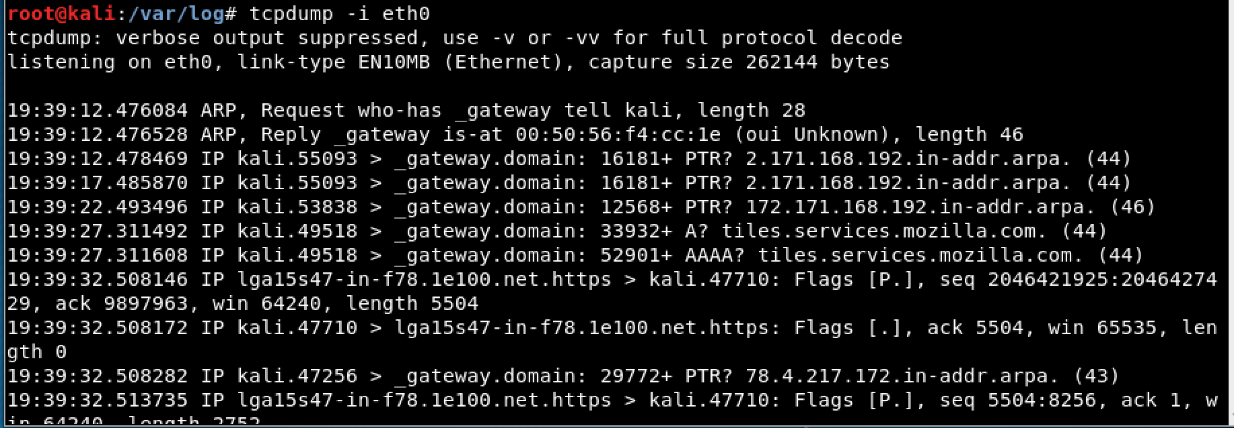
Network traffic
Still applicable
Correlate with weird processes
What if you don’t have Wireshark
Tcpdump

